Slide 1

Laboratory of Nearable Technologies for Health Data Science
Real-Time Motion-Resilient rPPG
Comparative Evaluation of Green, POS and CHROM rPPG Algorithms
Supervisors:
Andrea Moglia
Marco Brando Mario Paracchini
Asal Abbas Nejad Fard
10974178
July 2026
1

Slide 2

Project Pipeline
Face Detection
ROI Extraction
rPPG Extraction
GREEN / POS/ CHROM
Shared preprocessing
RGB Video
Shared HR estimation (FFT)
CMS50D Validation
Only the rPPG signal extraction method changes (Green, POS or CHROM); all preprocessing, HR estimation and validation steps are identical.
2

Slide 3
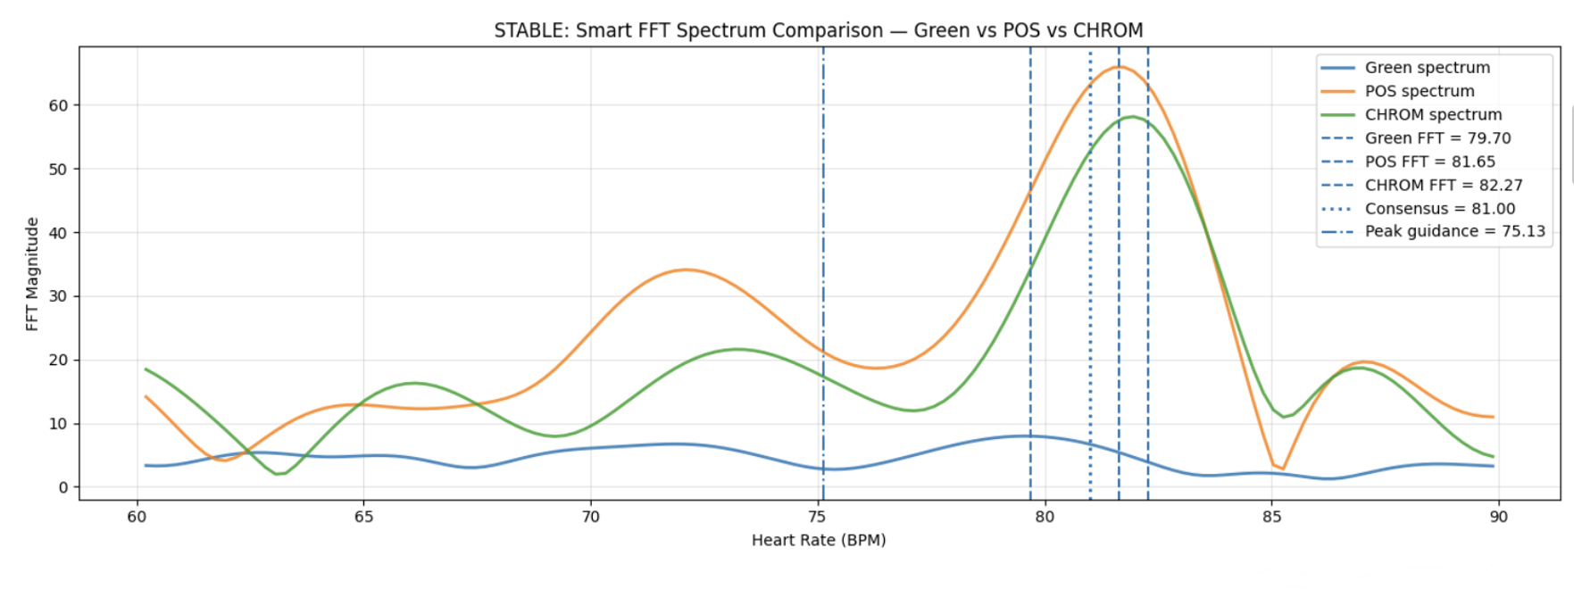
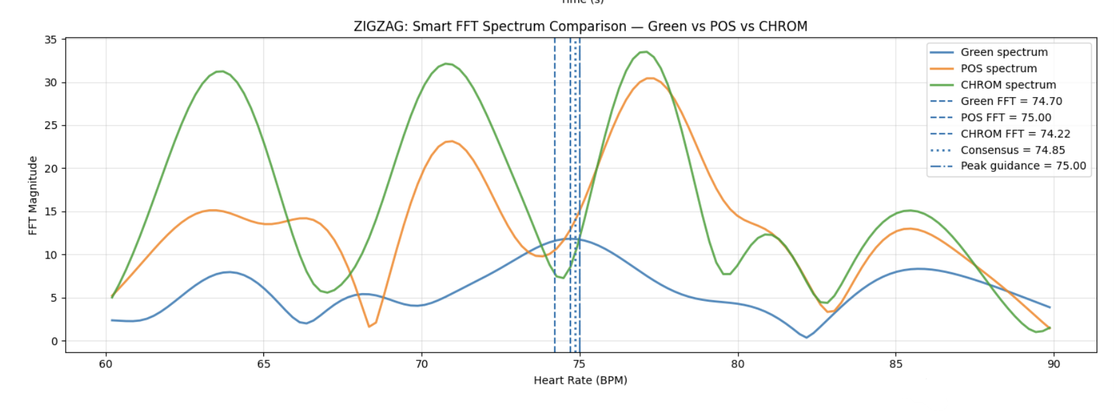
FFT Spectrum Comparison of Green, POS and CHROM
Key observations
• Same preprocessing
• Green has weaker peak
• POS and CHROM generate stronger peaks
• CHROM becomes more competitive under motion

Slide 4
Green vs POS vs CHROM
Feature | Green | POS | CHROM
Uses Green channel | ✓ | ✗ | ✗
Uses RGB | ✗ | ✓ | ✓
Motion robustness | Baseline | Medium | High (expected)
Computational cost | Low | Medium | Medium

Slide 5
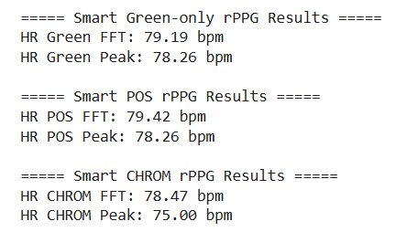
Stable Results
Method | MAE | Within ±3 BPM | Within ±5 BPM
Green | 2.82 | 57.1% | 85.7%
POS | 2.67 | 57.1% | 92.9%
CHROM | 2.79 | 57.1% | 85.7%
Example Recording:
GT=79.5 BPM
Ranking Comparison (Stable):
1. POS
2. CHROM
3. Green
POS achieved the lowest average MAE in stable recordings, although the three methods remained relatively close.

Slide 6
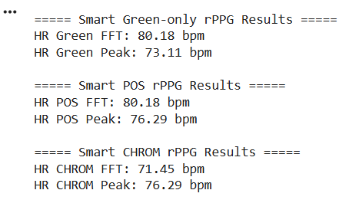
Zigzag Results
Method | MAE | Within ±3 BPM | Within ±5 BPM
Green | 1.74 | 91.7% | 100%
POS | 2.04 | 83.3% | 100%
CHROM | 3.75 | 50.0% | 75.0%
Example Recording:
GT = 83 BPM
Ranking Comparison( Zigzag):
1. Green
2. POS
3. CHROM
Green remained the most robust method under motion.
Adaptive rPPG Signal Conditioning Router

Slide 7
Why CHROM Performs Well
Stable RGB relationships
Moderate illumination variation
Good ROI tracking
Correct spectral peak preserved
Why CHROM Sometimes Fails
Motion-induced shading
ROI displacement
RGB channel ratio changes
Adaptive coefficient amplified noise
Wrong FFT peak selection
CHROM performance strongly depends on color stability and accurate ROI tracking.

Slide 8
Conclusion
Best in stable? | POS ✓ Lowest MAE
Best in zigzag? | Green ✓ Highest robustness
Did CHROM improve robustness? | Not consistently
Same ranking? | No
Is CHROM justified as default? | No
CHROM may be useful as an optional method, but it is not justified as the default method based on our dataset.

Slide 9
References: 1. Verkruysse, W., Svaasand, L. O., & Nelson, J. S. (2008). Remote plethysmographic imaging using ambient light. Optics Express. 2. Wang, W., den Brinker, A. C., Stuijk, S., & de Haan, G. (2017). Algorithmic Principles of Remote PPG. IEEE Transactions on Biomedical Engineering. 3. de Haan, G., & Jeanne, V. (2013). Robust Pulse Rate From Chrominance-Based rPPG. IEEE Transactions on Biomedical Engineering.

Slide 10
Thank you for your attention!

